Slide 1
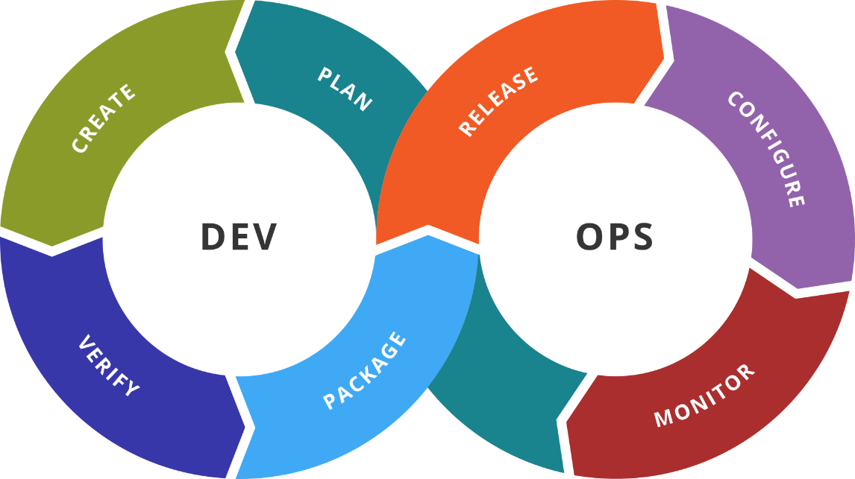
Jenkins
Advanced Techniques
SoftUni Team
Technical Trainers
Software University
https://softuni.org

Slide 2
You Have Questions?
sli.do
#DevOps-23
facebook.com
/groups/DevOpsContainerizationCICDMonitoringJanuary2023

Slide 3
Homework Progress
Solutions for M4
can be submitted
until 23:59 on --.--.2023
Solutions for M5
can be submitted
until 23:59 on --.--.2023

Slide 4

Previous Module (M4)
Quick Overview

Slide 5
What We Covered
Introduction to Jenkins
Working with Jenkins
Remote Tasks
Schedules
Plugins
Advanced Jenkins
Building with Docker
Pipelines

Slide 6

Dev
Ops
This Module (M5)
Topics and Lab Infrastructure

Slide 7
Table of Contents
Remote (slave) hosts
Working with Jenkins using CLI
Export and Import jobs
Blue Ocean
SCM integration

Slide 8
Lab Infrastructure
NETWORK: 192.168.99.0/24
.101
.102
VM1
Jenkins
VM2
Docker
VirtualBox
Vagrant
Windows / Linux / macOS

Slide 9
Dev
Ops
Offload Jenkins Host
Using remote (slave) hosts

Slide 10
Why Offloading?
It is not considered good practice to execute jobs on the host
Instead, we can register nodes and use them as executors
We can mix and match platforms and environments
Furthermore, we can have on-premises and cloud hosts
We can even have virtual machines and physical machines
This will increase not only the variety but also the capacity

Slide 11
Procedure
Credentials and keys setup
Register a node
Assign label(s)
Configure # of executors, workspace, etc.
Deploy an agent
Start using it

Slide 12
Dev
Ops
Practice: See It in Action
Live Demonstration in Class

Slide 13
Dev
Ops
Control Jenkins
Using Command Line Interface (CLI)

Slide 14
Jenkins CLI
Users and administrators can use script or shell environment
It allows access over SSH
Or via downloadable CLI client
We can use either HTTP, SSH or WebSocket to work with the CLI
In addition, there is a Groovy-based script console

Slide 15
Partial List of Commands
help can be used to get the list of all commands or information about specific command
list-jobs returns a list of all available jobs
build allows for job execution
create-job is used to create jobs out of XML
get-job returns a job represented in XML
copy-job allows to duplicate a job
delete-job can be used to delete jobs permanently

Slide 16
Dev
Ops
Jobs Management
Export / Import

Slide 17
Jobs Management
We can export job from one instance and import it on another
The same can be applied on one and the same instance
This technique is useful for backup purposes as well
Last but not least, it allows for automation or zero touch deployment
Relies on the command line tools
There are specialized plugins as well

Slide 18
Dev
Ops
Pipelines In Focus
Blue Ocean

Slide 19
Blue Ocean
Set of plugins focused on (multibranch) pipelines
Completely different interface and tooling
Visual pipeline editor
Visual pipeline representation
GitHub & Git integration
Instant problem diagnosis

Slide 20
Dev
Ops
Practice: See It in Action
Live Demonstration in Class

Slide 21
Dev
Ops
SCM Integration
Pipeline Hosting and Webhooks

Slide 22
Pipeline SCM Integration
Complex pipelines are difficult to maintain in Jenkins classic UI
Instead, we can work in IDE of our choice and use an SCM
We store the pipeline code in Jenkinsfile
During the build, Jenkins automatically checks out the file
During job creation we point out where the Jenkinsfile is
We can use the snippet generator that can be found here
${YOUR_JENKINS_URL}/pipeline-syntax

Slide 23
Webhooks
No matter where the pipeline code is, we can use webhooks to link the build process with changes in the SCM
There are different plugins that expose endpoints in Jenkins
Some of them are specialized and others are more generic
They are called from the SCM when there is a push for example
Some allow greater control like filtering for example

Slide 24
Dev
Ops
Practice: See It in Action
Live Demonstration in Class

Slide 25

Resources
Jenkins site
https://jenkins.io/
Jenkins installation guide
https://jenkins.io/doc/book/installing/
Jenkins Pipeline guide
https://jenkins.io/doc/book/pipeline/
Managing Jenkins
https://jenkins.io/doc/book/managing/
Jenkins plugins
https://plugins.jenkins.io/
…
…
…

Slide 26
Questions?
Notes:
26

Slide 27














SoftUni Diamond Partners

Slide 28

Educational Partners

Slide 29

License
This course (slides, examples, demos, exercises, homework, documents, videos and other assets) is copyrighted content
Unauthorized copy, reproduction or use is illegal
© SoftUni – https://softuni.org
© Software University – https://softuni.bg
Notes:
29

Slide 30
Trainings @ Software University (SoftUni)
Software University – High-Quality Education, Profession and Job for Software Developers
softuni.bg, softuni.org
Software University Foundation
softuni.foundation
Software University @ Facebook
facebook.com/SoftwareUniversity
Software University Forums
forum.softuni.bg
Notes:
30

